Slide 1
SCD Example using Talend: Requirements
Track Employee Pay History
Data Sources: SQL Server 2014
[AdventureWorks2014].[HumanResources].[EmployeePayHistory]
[AdventureWorks2014].[HumanResources].[Employee]
[AdventureWorks2014].[Person].[Person]
Target: SQL Server 2014
[neu_training].[dbo].[EmployeePayHistory]
Note: you can place table in whatever database you want to use for training
Create target table script
SCD Example - create tables EmployeePayHistory.sql

Slide 2
SCD Example using Talend: Data Source

Slide 3
SCD Example using Talend: Create Table Script
CREATE TABLE EmployeePayHistory(
[PayHistorySK] [int] identity(1,1) NOT NULL,
[EmployeeID] [int] NOT NULL, -- BusinessEntityID
[NationalIDNumber] [nvarchar](15) NOT NULL,
[FirstName] [nvarchar](50) NOT NULL,
[LastName] [nvarchar](50) NOT NULL,
[MiddleName] [nvarchar](50) NULL,
[LoginID] [nvarchar](256) NOT NULL,
[JobTitle] [nvarchar](50) NOT NULL,
[BirthDate] [date] NOT NULL,
[MaritalStatus] [nchar](1) NOT NULL,
[Gender] [nchar](1) NOT NULL,
[HireDate] [date] NOT NULL,
[VacationHours] int DEFAULT ((0)),
[SickLeaveHours] int DEFAULT ((0)),
[CurrentFlag] bit DEFAULT ((1)),
--[RateChangeDate] [datetime] NOT NULL, use for Rate_EffectiveDate
[Rate] numeric(15,2) NOT NULL,
[PayFrequency] [int] NOT NULL,
[ModifiedDate] [datetime] NOT NULL,
[Rate_EffectiveDate] [date] NOT NULL, -- SCD_State
[Rate_IneffectiveDate] [date] NULL, -- SCD_End
[SCD_Version] [int] NULL,
[SCD_Active] [bit] NOT NULL DEFAULT ((0)),
[DI_Job_ID] [nvarchar](20) NOT NULL,
[DI_Create_Date] [datetime] NOT NULL default getdate(),
[DI_Modified_Date] [datetime] NOT NULL default getdate(),
PRIMARY KEY CLUSTERED ([PayHistorySK] ASC));

Slide 4
SCD Example using Talend: S2T

Slide 5
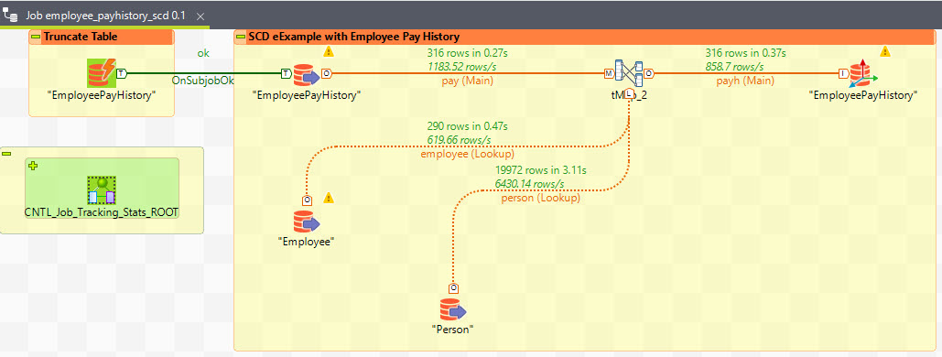
SCD Example using Talend: Talend Job

Slide 6
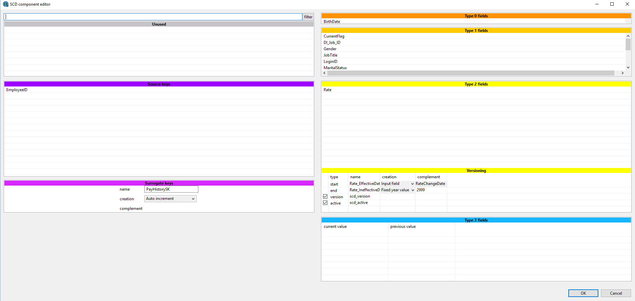
SCD Example using Talend: Talend Job

Slide 7
SCD Example using Talend: Training Steps
Run script
SCD Example - create tables EmployeePayHistory.sql
Note: uses neu_training– either create this database or alter script
Logon to Talend
Create metadata to connect to the table above
Create Talend SCD job

